Slide 1
MIS 7720 #3 Search and Planning in AI

Slide 2
Outline
Solving problems by searching
Constraint satisfaction problems
Planning in AI

Slide 3
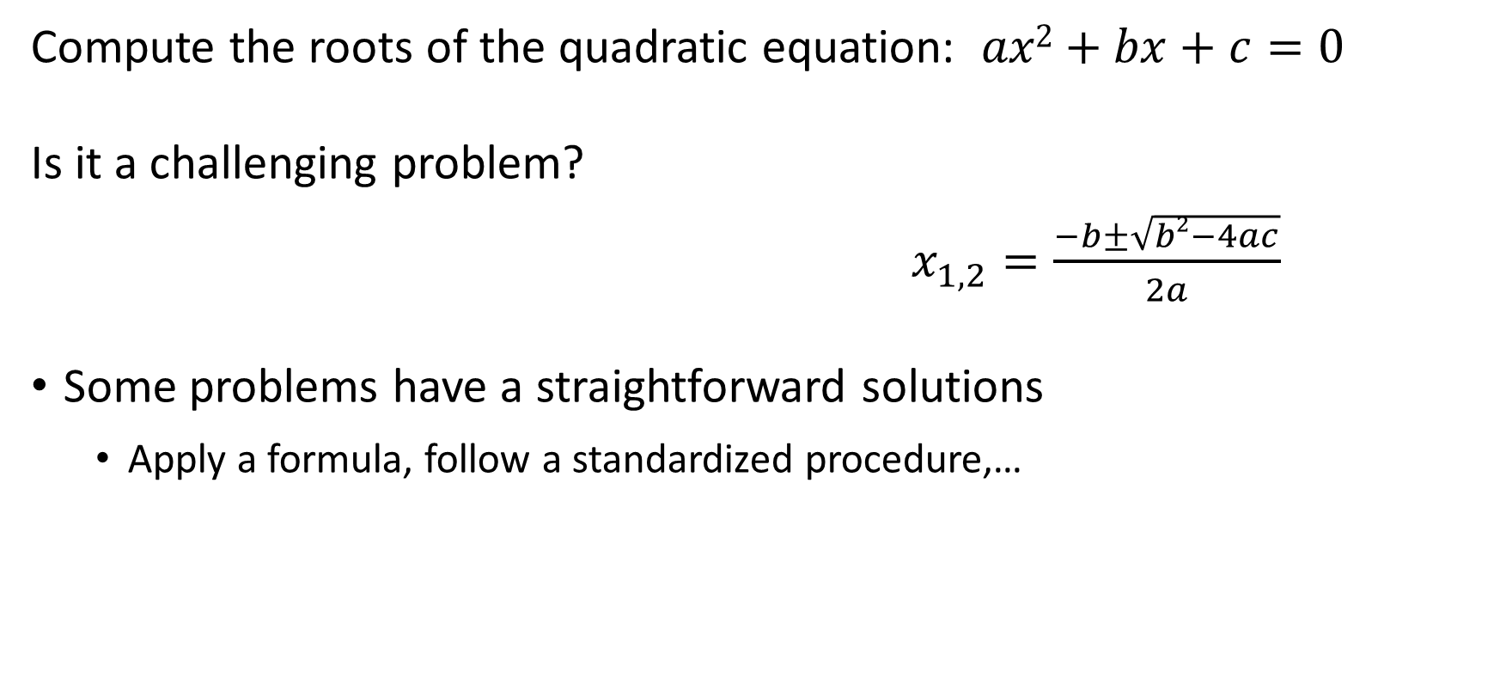
Example
Compute the roots of the quadratic equation: $ax2+bx+c=0$
Is it a challenging problem?
$x_{1,2}=\frac{−b±\sqrt{b2−4ac}}{2a}$
Some problems have a straightforward solutions
Apply a formula, follow a standardized procedure,…

Slide 4
Some problems require search
Several alternatives have to be explored
There can be very large number of alternatives (even infinite)
You choose the alternative that gives you a better outcome
There might be more than one solution

Slide 5
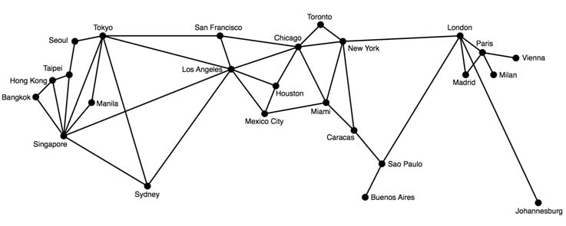
Example: route finding problems
What is the shortest route between two cities
Notes:
Shortest path problem

Slide 6
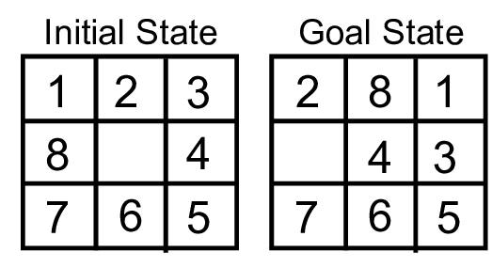
Example: 8-puzzle
Find the sequence of the “empty tile” moves from the initial game position to the target position
Notes:
Other examples: chess, poker, warcraft, …

Slide 7







Search problems
A search problem consists of:
State space
Actions
A set, e.g., {N,E,W,S}
Results; (s,a) →s’
Taking action a in state s
Path cost
Cost of going from s to s’ via action a
A start state and a goal test
A solution is a sequence of actions (a plan) which transforms the start state to a goal state
“N”, 1.0
“E”, 1.0
Notes:
Goal test – sometimes more than one state that satisfies having achieved the goal, for example, “eat all the dots”
Search problems are models (abstractions)
We have an Agent that has to explore the search space to get to a Goal (state); has to search through the solution space to provide the best result

Slide 8
Real world examples using search
Route finding problem : Example of applications include tools for driving directions in websites, in-car systems, etc.
Travelling salesman problem : Find the shortest tour to visit each city exactly once.
VLSI Layout : position million of components and connections on a chip to minimize area, shorten delays.
Robot Navigation : Special case of route ﬁnding for robots with no speciﬁc routes or connections, where state space and action space are potentially infinite.
Automatic assembly sequencing : ﬁnd an order in which to assemble parts of an object which is a diﬃcult and expensive geometric search.
Protein design : ﬁnd a sequence of amino acids that will fold into a 3D protein with the right properties to cure some disease

Slide 9
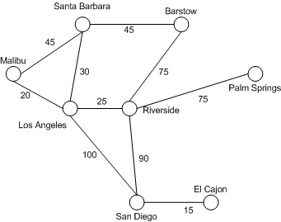
Apply terminology to the route finding problem

Slide 10
Apply terminology to the route finding problem
Frontier
Cost
Explored
Start State
Unexplored
Goal State

Slide 11
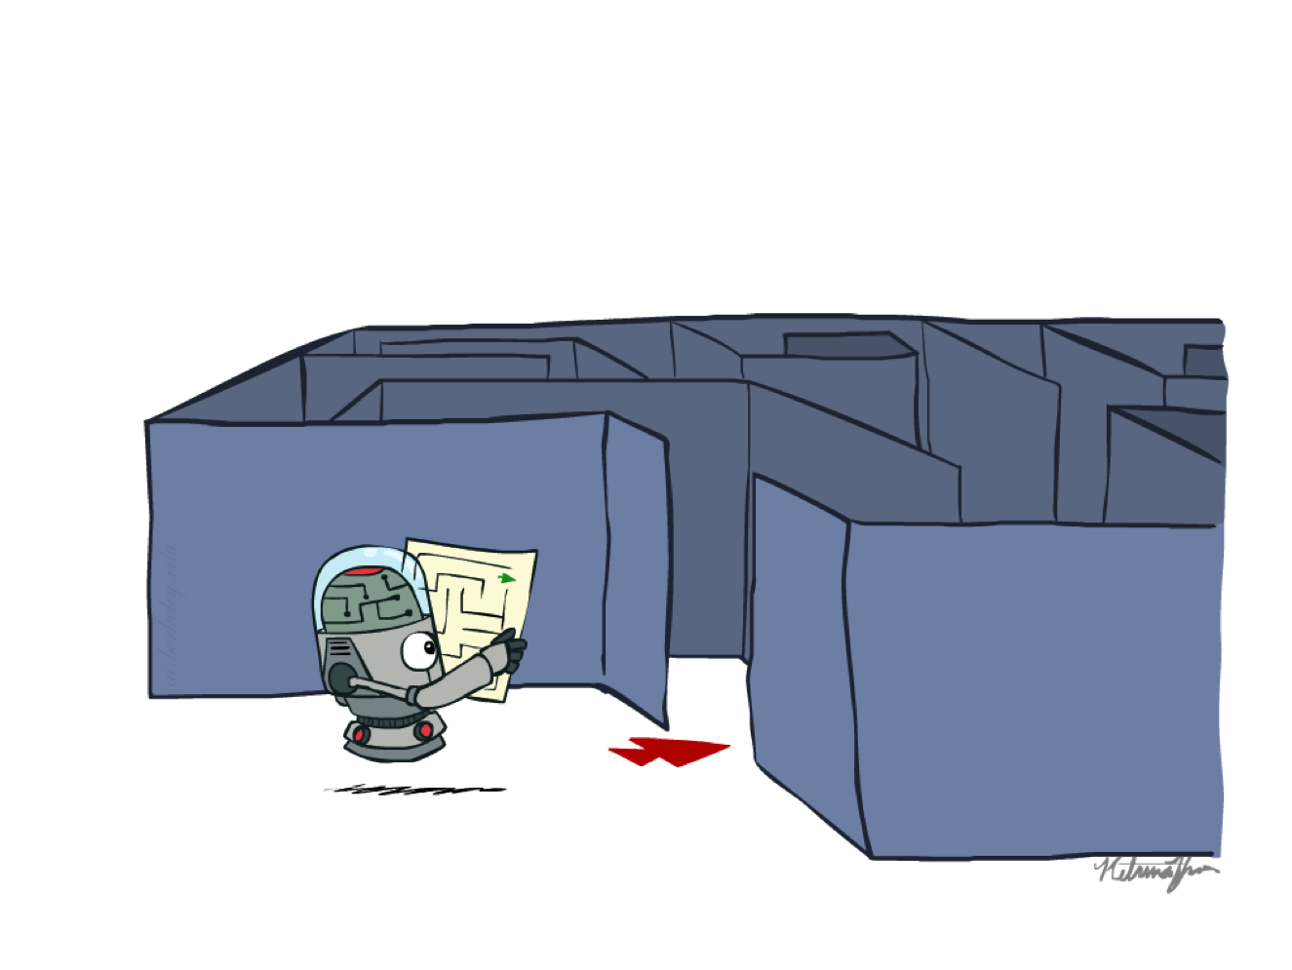
Search overview
Search problem:
States (configurations of the world)
Actions and costs
Successor function (world dynamics)
Start state and goal test
Search tree: represents the search space
Nodes: represent plans for reaching states
Plans have costs (sum of action costs)
Search algorithm:
Systematically builds a search tree
Chooses an ordering of the fringe (unexplored nodes)
Optimal: finds least-cost plans

Slide 12
Uninformed search
Does not use any domain knowledge.
Does not use any information that helps it reach the goal. These algorithms ignore where they are going until they find a goal and report success.
BFS(Breadth First Search): It expands the shallowest node(node having lowest depth) first.
DFS(Depth First Search): It expands deepest node first.
DLS(Depth Limited Search): It is DFS with a limit on depth.
IDS(Iterative Deepening Search): It is DFS with increasing limit
UCS(Uniform Cost Search): It expands the node with least cost (Cost for expanding the node).

Slide 13
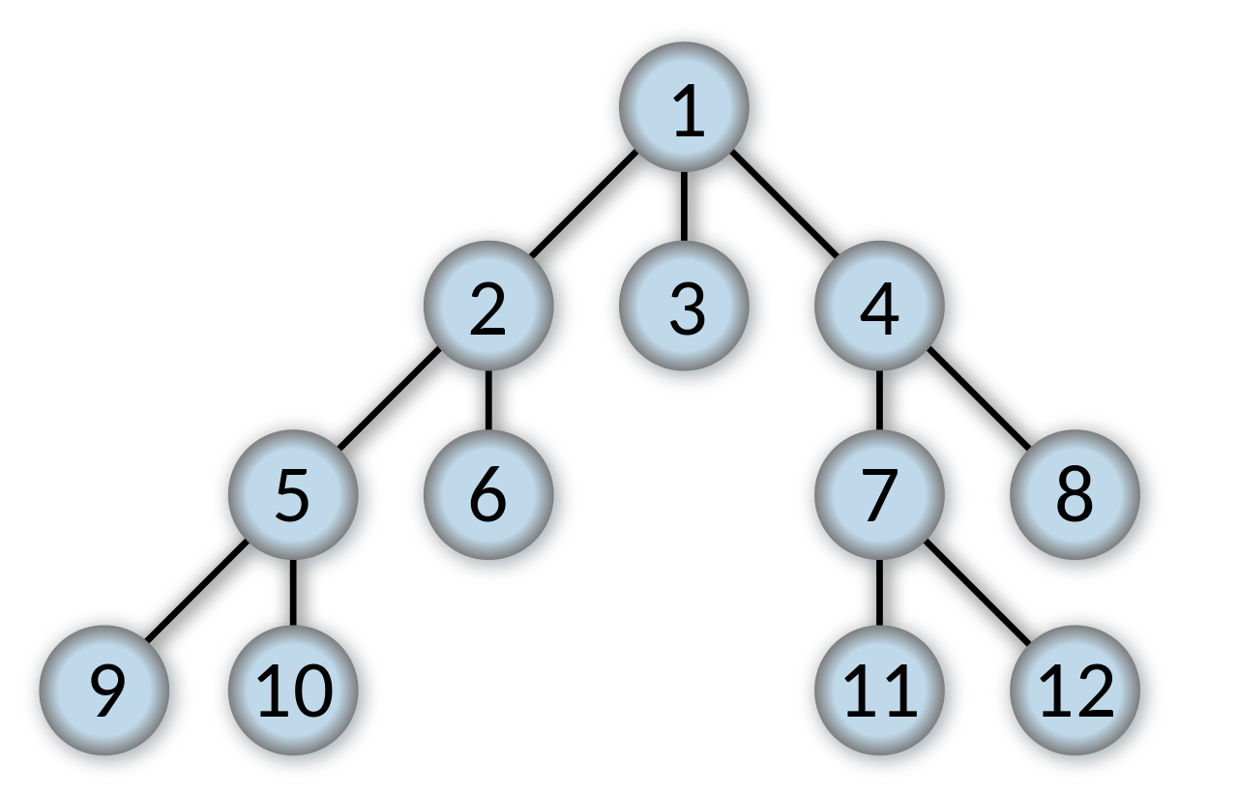
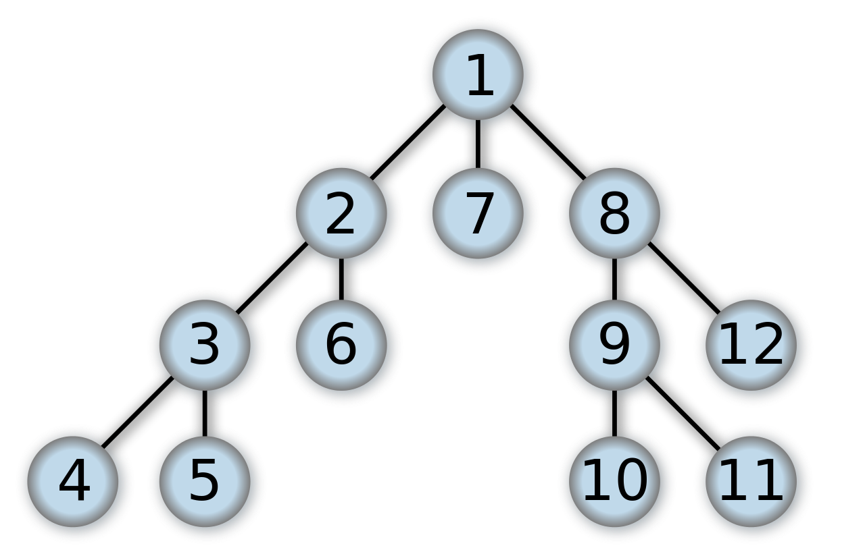
BFS and DFS
Breadth First Search
Depth First Search

Slide 14
Search Space
Cost
Start State
Goal State
Notes:
We have an agent and the goal state is “El Cajon”
Actions are the edges and have a cost associated with them.

Slide 15
Breadth First Search
Visited :
Malibu
SantaBarbara
LosAngeles
Barstow
Riverside
SanDiego
PalmSpring
ElCajon
Path of length 3 from Start go Goal
Notes:
BFS: tries to find the shortest path, does not account for cost
For a more detailed explanation, see https://www.youtube.com/watch?v=1wu2sojwsyQ&t=2s

Slide 16
Depth First Search
Visited :
Malibu
LosAngeles
SanDiego
ElCajon
Riverside
PalmSprings
Path of length 3 from Start go Goal
Goal!
Notes:
For another detailed example see https://www.youtube.com/watch?v=h1RYvCfuoN4

Slide 17
Depth First Search
Path of length 5 from Start go Goal
Notes:
For another detailed example see https://www.youtube.com/watch?v=h1RYvCfuoN4

Slide 18
Uniform cost search (cheapest first)
Visited :
Malibu
SantaBarbara
LosAngeles
Barstow
Riverside
SanDiego
PalmSpring
ElCajon
Notes:
UCS is a variant of Dijkstra’s (is an algorithm for finding the shortest paths between nodes in a graph)
For another example see, https://www.youtube.com/watch?v=dRMvK76xQJI

Slide 19
Informed search
Uses domain knowledge
Uses a heuristic function that estimates how close a state is to the goal. This heuristic need not be perfect. This function is used to estimate the cost from a state to the closest goal.
Greedy search (best first search) : It expands the node that appears to be closest to goal
A* search : Minimize the total estimated solution cost, that includes cost of reaching a state and cost of reaching goal from that state.
Notes:
For a detailed example and explanation of the A* search algorithm, see
https://www.youtube.com/watch?v=6TsL96NAZCo

Slide 20
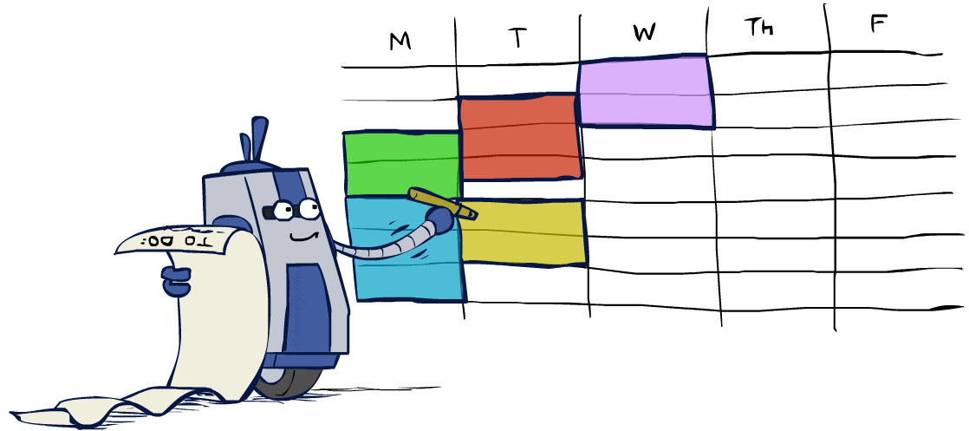
Constraint Satisfaction Problems (CSP)
CSPs are a special kind of search problem:
State is defined by variables X_{i} with values from a domain D (sometimes D depends on i)
Goal test is a set of constraints specifying allowable combinations of values for subsets of variables
For example: X₁ ≠ 3, X₃ > X₄
Constraint Satisfaction:
Finding a solution to a set of constraints that impose conditions on variables.
A solution is a set of values for the variables that satisfies all constraints
Basic solution: backtracking search
Other solutions: linear programming
Speed-ups:
Ordering
Filtering
Structure
Notes:
CSP: used in AI when we have a set of decisions to make in parallel that can be modeled as variables Xi, each with a set of choices D.
Excel solver (simplex LP) does a variation of this this

Slide 21
CSP Example: Map coloring
Notes:
Color each part on a map with k colors so that there are no neighboring parts with the same color

Slide 22
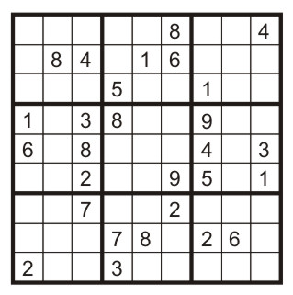
Example: Sudoku
Variables:
Each (open) square
Domains:
{1,2,…,9}
Constraints:
9-way alldiff for each column
9-way alldiff for each row
9-way alldiff for each region
(or can have a bunch of pairwise inequality constraints)

Slide 23

Backtracking Search
Backtracking search is the basic uninformed algorithm for solving CSPs
Idea 1: One variable at a time
Variable assignments are commutative, so fix ordering
i.e., [WA = red then NT = green] same as [NT = green then WA = red]
Only need to consider assignments to a single variable at each step
Idea 2: Check constraints as you go
i.e., consider only values which do not conflict previous assignments
Might have to do some computation to check the constraints
“Incremental goal test”
Depth-first search with these two improvements
is called backtracking search

Slide 24
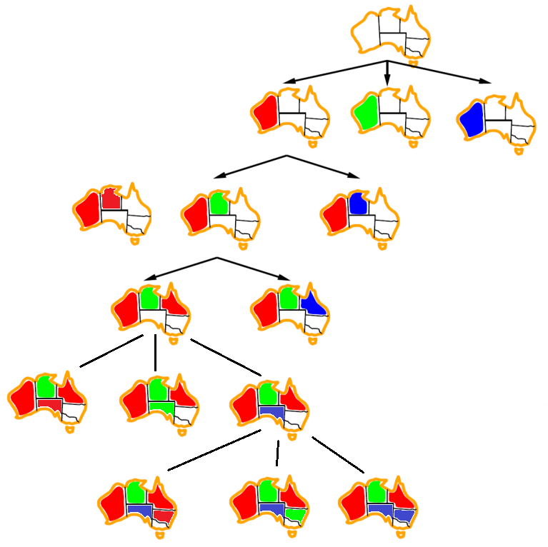
Backtracking Example
Notes:
red -> green -> blue

Slide 25
Backtracking Search
Backtracking = DFS + variable-ordering + fail-on-violation
Notes:
Pseudocode for backtracking search

Slide 26
Example: scheduling workforce
How to schedule my workforce efficiently?
All bank employees work five consecutive days
Minimum number of employees to still meet labor requirements for each day of the week
Notes:
Demo in excel using Solver

Slide 27
Search operates over models of the world
The agent does not try all the plans out in the real world!
Planning is all “in simulation”
Your search is only as good as your models of the world
Notes:
More on search algorithms in AI:
https://towardsdatascience.com/ai-search-algorithms-every-data-scientist-should-know-ed0968a43a7a

Slide 28
Shortcomings with search
Fully observable
Known
We have to know set of available actions
Discrete
Finite number of actions to chose from
Deterministic
Have to know the result of taking an action
Static
Nothing else that changes (our model of) the world
Notes:
The domain has to be …

Slide 29
Planning in AI

Slide 30
AI planning
AI planning = Automated planning and scheduling
Planning problem
Given possible initial states of the world, a description of the desired goals, and a set of possible actions,
Find a plan that is guaranteed to take us to a goal state (when applied to any of the initial states)

Slide 31
Applications
Robots and autonomous systems
Cybersecurity
Process flows
Digital assistant
Search & Rescue coordination
Space mission planning
…
Notes:
https://researcher.watson.ibm.com/researcher/view_group.php?id=8432

Slide 32
Brief overview
Classical planning: what to do, and in what order
Single agent, deterministic actions, known initial and goal states
Real-world planning: Time, schedule, resources
Markov Decision Process,…
Multiagent planning

Slide 33
STRIPS
Stanford Research Institute Problem Solver
Initial state
The specification of the goal states (desired state)
A set of actions. For each action, the following are included:
preconditions (what must be established before the action is performed)
postconditions (what is established after the action is performed)
Given these things, the algorithm can construct a plan by simple path-finding.
Notes:
Original paper (1971): http://ai.stanford.edu/users/nilsson/OnlinePubs-Nils/PublishedPapers/strips.pdf

Slide 34
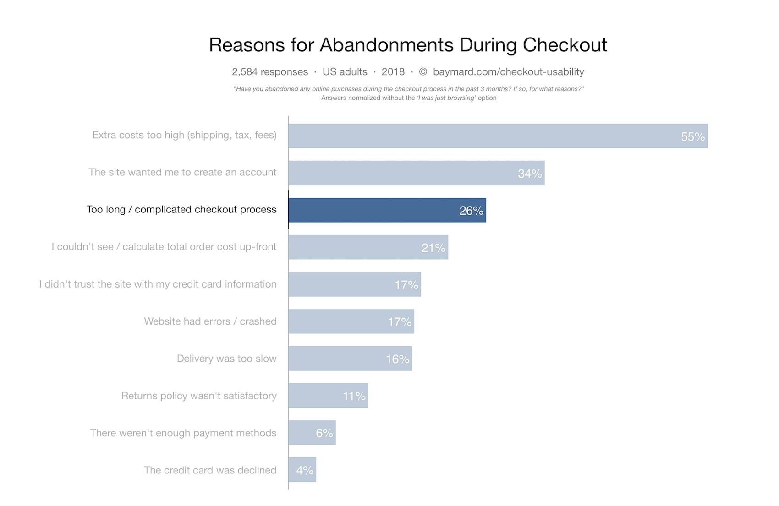
Example: Checkout flow
Checkout flow: the checkout process after an initial purchase decision has been made – hard to get right!

Slide 35
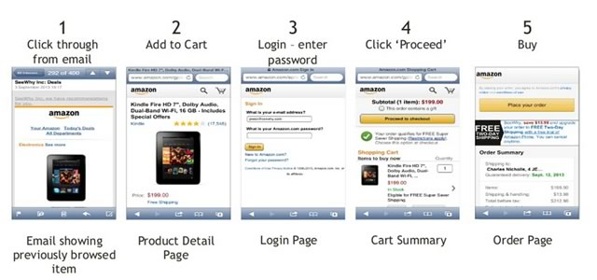
Checkout flow – Amazon mobile app

Slide 36
Checkout flow - possible issues
Filling in information that has nothing to do with their order¹.
Being asked questions that make no sense given their previous answers².
Manually repeating information that has already been given.
Filling in information that could have easily been predicted from earlier inputs³.
Having to go with the default when it doesn't make sense is also a problem⁴.
Having to go through much of the checkout process to find out that their order cannot be completed⁵.
Notes:
for example, shipping address for digital goods
for example, US state for shoppers from other countries
for example, city name after filling in ZIP code
for example, no way to enter different city name than what was, maybe, incorrectly guessed
for example, buying an item that is not available outside US

Slide 37
Checkout flow – STRIPS AI planning demo
Dynamically guide a shopper through a checkout flow according to different facts about the shopper and their order.
Given…
Initial state: we know nothing about the shopper
Goal state: we know everything we need about the shopper to be able to finish their order
Set of actions (that change state): e.g., ask the use about their name
Plan the best (min) sequence of steps for shopper to complete order
Notes:
https://filiph.net/eshop-ai/

Slide 38
Q&A

